Slide 1
WELCOME Parents and Students to “The Financial Aid Game”
www.principiaprep.com
Principia Prep’s Mission Statement:
The primary mission of Principia Prep is to educate parents and students about the financial aid and admissions process

Slide 2
Presentation Outline
www.principiaprep.com
The Good
The Bad
The Ugly
What is Financial Aid
The FAFSA Form & The CSS Profile Form
Award Letter
What will college really cost my family?
Will my family qualify for Aid?
What are my families options for paying for college

Slide 3
4Years or 5?
www.principiaprep.com
College’s require 124 to 128 Credits to graduate a 4 year institution
12CR X 2 (Semester Per Yr) = 24 X 4 (Year in School) = 96 Credits
15CR X 2 (Semester Per Yr) = 30 X 4 (Year in School) = 120 Credits
15CR (Each Semester 3 Yr) + 2 Summer & Winter = 126
90 Credits + 36 Credits
6 and 7 year plans also available

Slide 4
The Bad
www.principiaprep.com
Average College Cost
• Public $14,000 to $35,000
Private $30,000 to $60,000
Elite $60,000 to $85,000

Slide 5
They have now crossed over $70,000
www.principiaprep.com
Columbia Univ. $82,385
Fordham Univ. $76,955
NYU $76,757
George W. Univ. $75,907
Drew Univ. $58,944
* Numbers account for tuition, room and board and misc cost

Slide 6
Are you Financially Fit or Academically Sound
www.principiaprep.com
Where is your advantage
GPA & SAT
Family Finances

Slide 7
Merit Aid
www.principiaprep.com
Academic
GPA, Class Standing, SAT Score
Athletic
Scholarship or help with admission
Neglected Resources
College’s own money

Slide 8
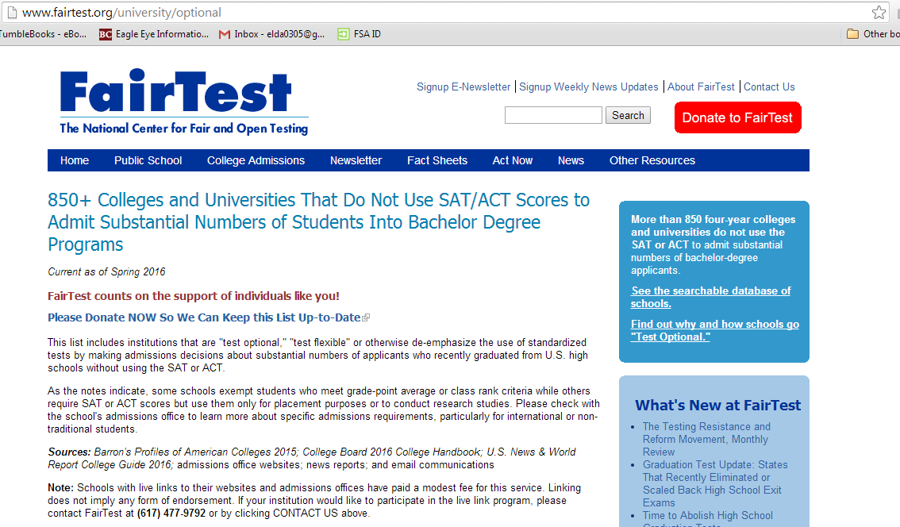
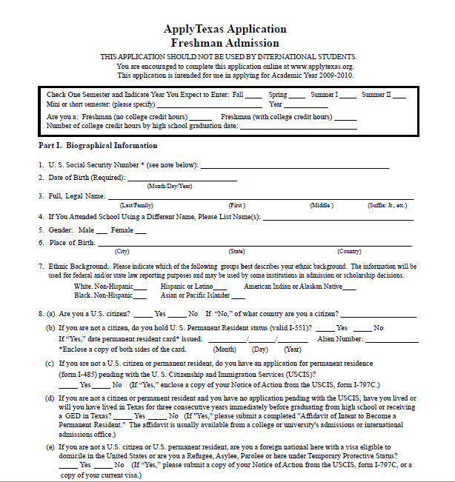
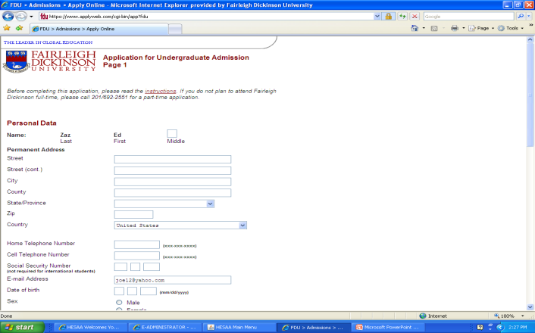
www.principianp.com
Online or Paper form
What is your best bet
Application Fees
Reliability
Making deadlines
Making it easy
Paper forms are becoming extinct
WWW.FAFSA.GOV

Slide 9
HOW DO I QUALIFY?
www.principiaprep.com
COST OF ATTENDANCE (COA)
MINUS
EXPECTED FAMILY CONTRIBUTION (EFC)
FINANCIAL NEED

Slide 10
www.principiaprep.com
WHAT COMPRISES COA?
TUITION AND FEES
ROOM AND BOARD
PERSONAL EXPENSES
BOOKS, SUPPLIES, COMPUTER
TRANSPORTATION
LOAN FEES

Slide 11
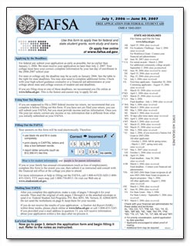
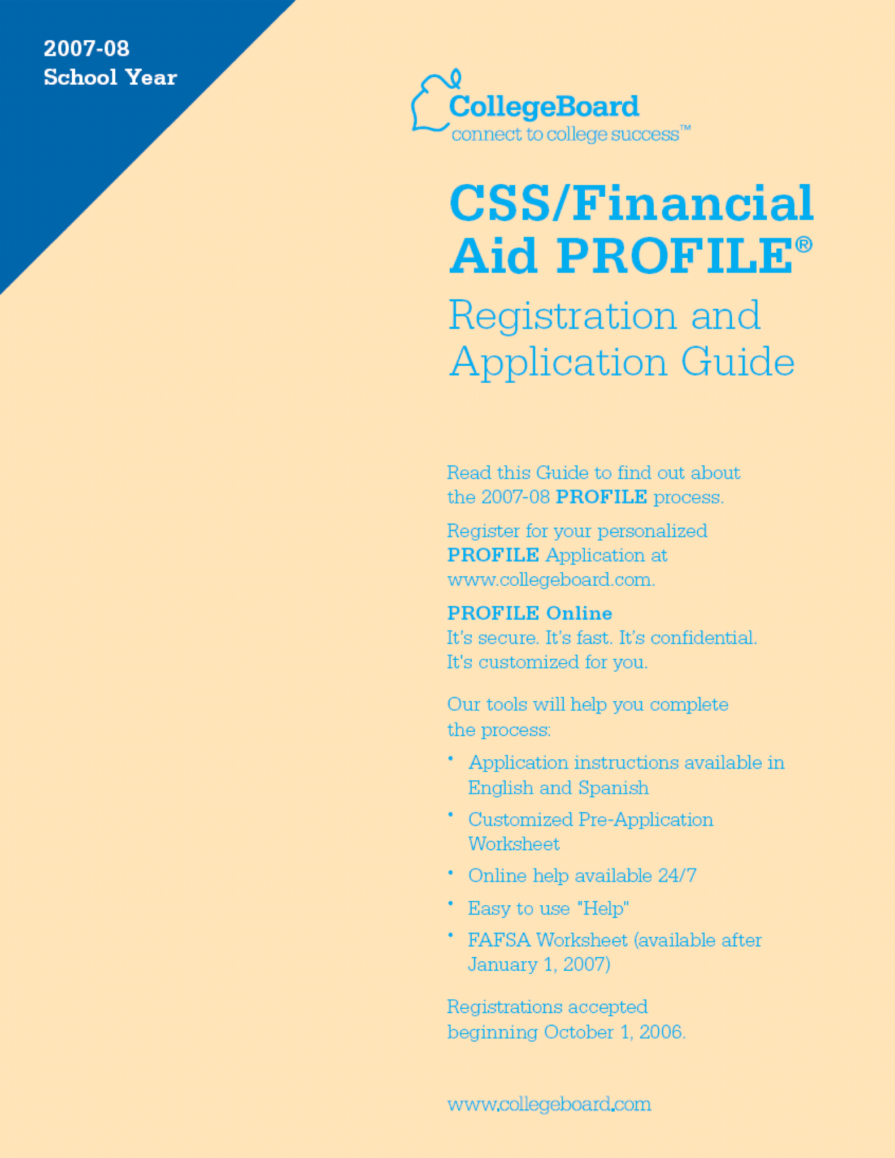
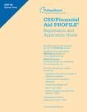
Which Form Do I fill Out?
www.principiaprep.com
FAFSA FORM
CSS PROFILE

Slide 12
www.principianp.com
Online or Paper form
What is your best bet
Application Fees
Reliability
Making deadlines
Making it easy
Paper forms are becoming extinct
WWW.FAFSA.ED.GOV

Slide 13
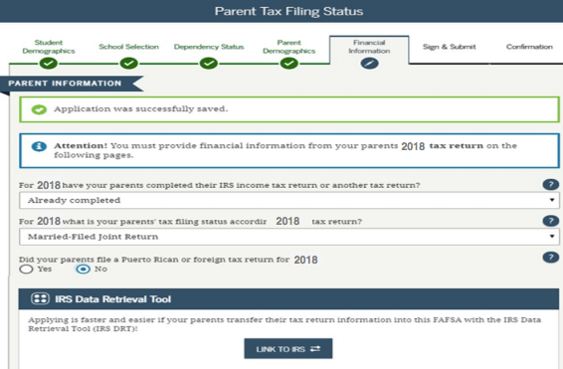
Applicants and parents will be instructed to provide financial
information from their 2018 tax return
www.principiaprep.com

Slide 14
Fafsa Counts
www.principiaprep.com
Cash, Savings, Checking
Stocks and Bonds
Mutual Funds
Second Homes
Child Support
Untaxed Income
Retirement Contributions

Slide 15
Hesaa Requirements
www.principiaprep.com
Drivers License
Student’s Social Security Benefits
Student’s
Student’s Earned Income Credit
Parent’s Social Security Benefits
Parent’s Earned Income Credit

Slide 16
Hesaa Requirements
www.principiaprep.com

Slide 17
www.principiaprep.com
Expected Family Contribution (EFC)
Parent’s Formula
Parents' Income - A Living Allowance (family size)- Taxes x 22% to 47% = Parents’ Contribution from Income
Parents’ Assets - Asset Protection Allowance (age based) x 5.6% = Parents’ Contribution from Assets
Student’s Formula
Students’ Income - Income Taxes - Standard Deduction of $3,500 X 50% = Students’ Contribution from Income
Students’ Assets - no deductions X 20% = Students’ Contribution from Assets

Slide 18
Starting the process on Collegeboard.org
www.principiaprep.com
Important Things to know
Institutional Methodology is the formula created by Private Colleges to determine the EFC.
Primary Residence and Retirement Accounts are assessed
Used by Private and Elite Colleges
Information Collected by CSS Profile
*START DEPENDS*

Slide 19
Profile Counts
www.principiaprep.com
Cash, Savings, Checking
Stocks and Bonds
Mutual Funds
529 Plans
Second Homes
Child Support
Non-Custodial Parents Information
Home and Car Value
Untaxed Income
Retirement Accounts

Slide 20
Net Price Calculator
www.principiaprep.com

Slide 21
For Divorced or Remarried Parents:
www.principiaprep.com
FAFSA does not consider the income and assets of the non-custodial parent in determining aid.
If the custodial parent has remarried, the spouse is considered a parent, and that person’s income and assets are counted.

Slide 22
www.principiaprep.com
Two in College
One Student Two Students
COA $35,000 $70,000
EFC $20,000 $20,000
Expected Family Contribution is divided by the number of students

Slide 23
Frequent Filing Errors
www.principiaprep.com
Parent and student Social Security Numbers
Divorced/remarried parental information
Untaxed income
U.S. income taxes paid
Household size
Number of household members in college
Real estate and investment net worth

Slide 24
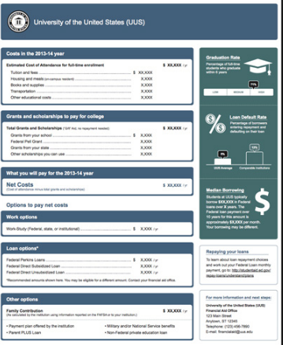
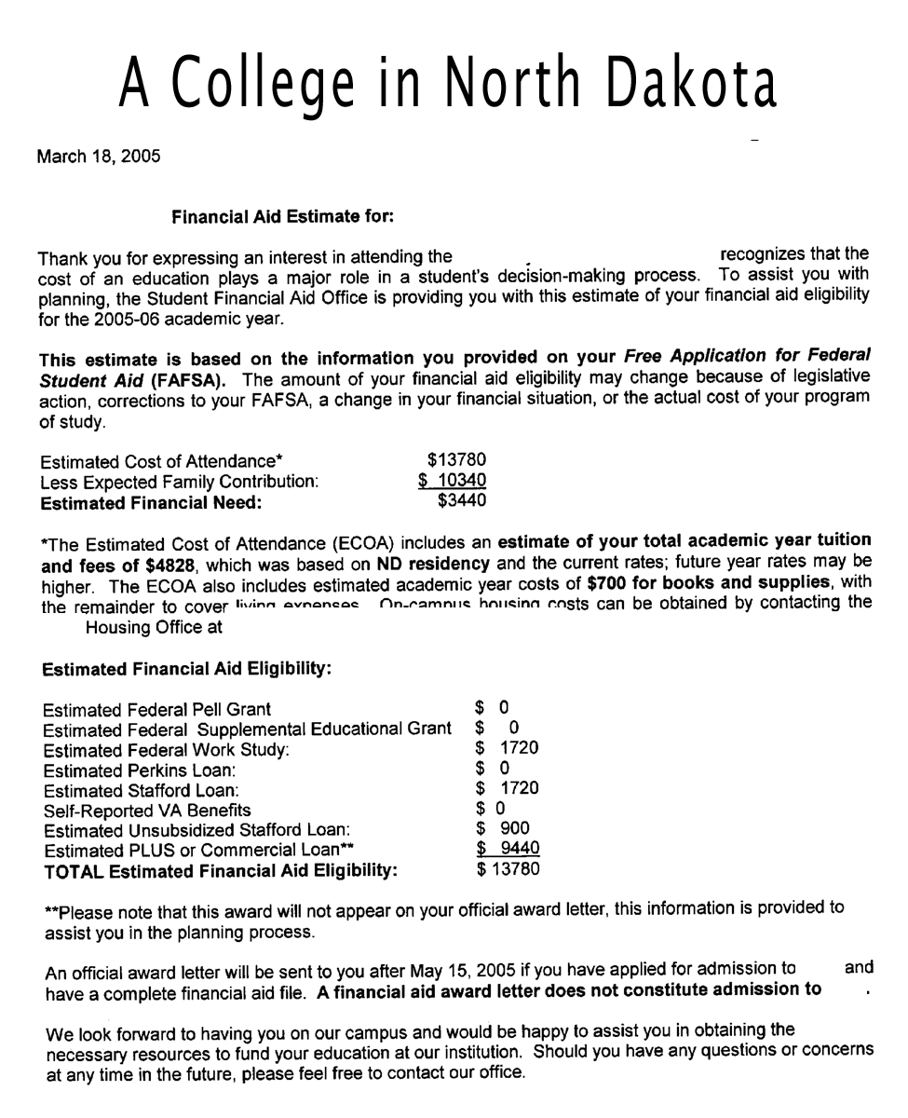
The Award Letter
www.principiaprep.com
What is on the Award Letter
The Cost of Attendance
The EFC
Estimated Financial Aid
Scholarships
Grants
Loans
Work-Study

Slide 25
Let’s Make a Deal
www.principiaprep.com
You can ask for more
Always ask for more
Use similar colleges
Be pro-active but not rude
If you don’t ask you will never know

Slide 26
Meeting a Student’s Financial Need
www.principiaprep.com
Choose your college wisely, because:
Not all will meet 100% of need
Private colleges generally:
Meet a higher percentage of need
Award a higher percentage of gift aid
Many students can attend a private college for the same cost as a public university!

Slide 27
Private VS. Public
www.principiaprep.com

Slide 28
www.principiaprep.com
Loans
Direct Loans
- Subsidized
- Unsubsidized
Perkins Loans
- Need based loan
PLUS Loans
-Parent Loans

Slide 29
www.principiaprep.com
Loans Part II
NJ Class
Sallie Mae
Wells Fargo
Citi Bank
Chase
PNC

Slide 31
The Green Scholarships
www.principianp.com
E-Waste Includes:
Computers
Laptop Computers
PDA’s
Sports equipment
T-I Calculators
Stereo equipment
Printers
Business &
Office Equipment
DVD Players
Toner (full or empty)
Cameras
*We do pick up materials at offices.

Slide 32
Additional Information
www.principiaprep.com
Financial Aid:
www.fafsa.ed.gov
www.collegeboard.ORG
Scholarship Searches:
www.fastweb.com
www.finaid.com
Follow US On:
Facebook Principia Prep
Instagram Principia Prep

Slide 33
Know Your Advantages
www.principiaprep.com

Slide 34
Ed’s Information info@principiaprep.com Phone 908-400-1363

